Slide 1
Set up eye tracker at MRT

Slide 2
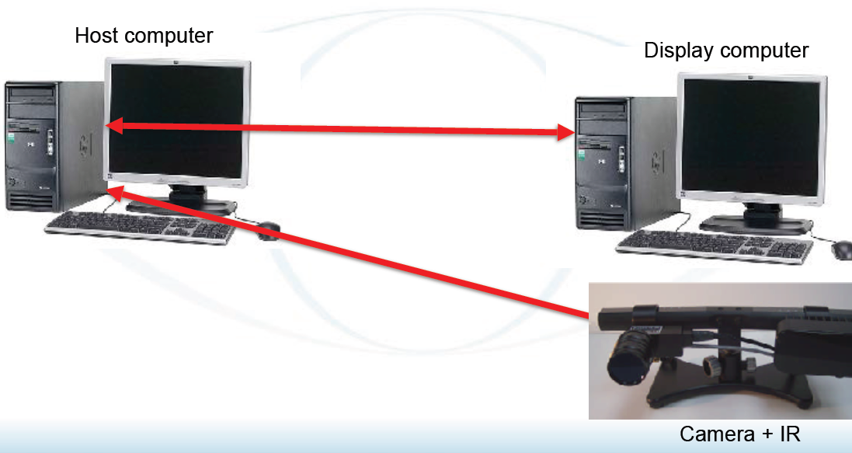
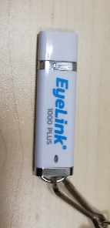
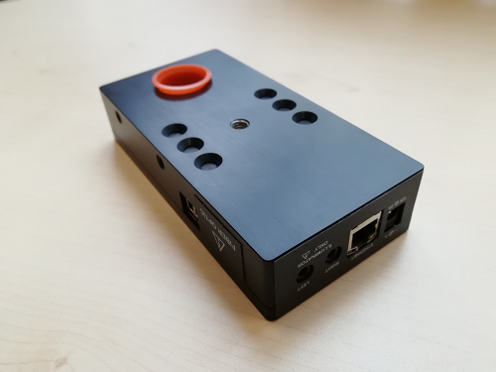
Overview
You need to have the EyeLink software installed on your stimulation computer !
(it is on a USB Key at the Sterzers Lab)
It carries also the manuals!
Eye tracker, long range set-up
Black box, most expensive,
handle with extra care

Slide 3
Connect eye tracker
place eye tracker in the scanner, in a specific position (marked by a tape in MRT2) for this position the eye tracker is adjusted ( if you set up the eye tracker the first time in a new environment read the EyeLink Manual!)
Do only start Host (= eye tracking computer) when everything is connected
connect all cables (no specific temporal order)
experimenter room:
power supply to black box
Ethernet cable to black box
scanner room:
power supply for eye tracker (power plug in the experimenters place), connected through the wall (use of filter; filter does not be in the scanner room), power cable must be placed as far away from the scanner as possible (otherwise might obscure the magnetic field), power cable need to come out of scanner tube straight as far as possible
light fiber for eye tracker connect to black box in the experimenters room, trough the wall connect to the eye tracker

Slide 4
Connect eye tracker
start host pc (if you start the host pc before you connected everything, it does not recognize the light fiber cable but tries to use the build in sensor instead)
connect stimulus computer to host computer with Ethernet cable
You can test if you can reach the eye tracker if you open an Explorer window (Internet Explorer, Google Chrome, Firefox) and typ in the address line: 100.1.1.1 (the IP address of the eye tracker host computer). If you press enter, there should be written “eye tracker running”.
If this does not work there is a problem with the Ethernet connection
Check IP-address
On the presentation c omputer
go to 'Systemsteuerung' -> 'Netzwerk und Freigabecenter' -> 'Status LAN-Verbingung' -> 'Eigenschaften' -> 'Internetprotokol version 4 (TCP/IPv4) -> Konfigurieren
Set: IP-Adresse to 100.1.1.2 ; Subnetzmaske to 255.255.255.0
press OK
test again the connection using an Explorer window (see above)
Sometimes problems arise due to internet security or firewall settings. There might be different solutions.. in this moment: Google is your friend!

Slide 5
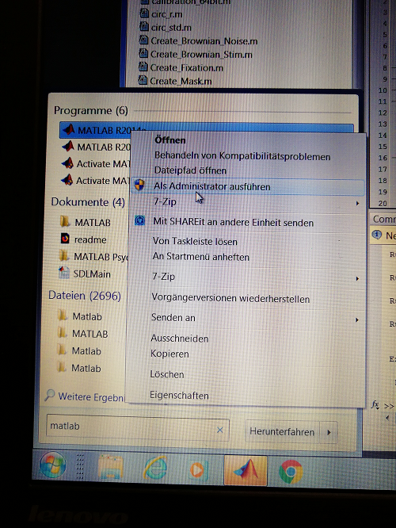
Set sup scanner
Set up the scanner equipment as usual (Monitor, button box, ..)
Important: replace the normal mirror on the head coil with the mirror for the eye tracker
( they are different in the reflecting material, where the average mirror leads to a blurred image and the eye tracker mirror not)
Place the subject in the scanner with the normal routine
Run MatLab in administrator mode
Now you can start your script, running the experiment (see how to control the eye tracker using Matlab in the powerpoint presentation “Integrate EyeLink and Matlab”
If your script works sufficiently, it should now start the eye trackers calibration routine

Slide 6
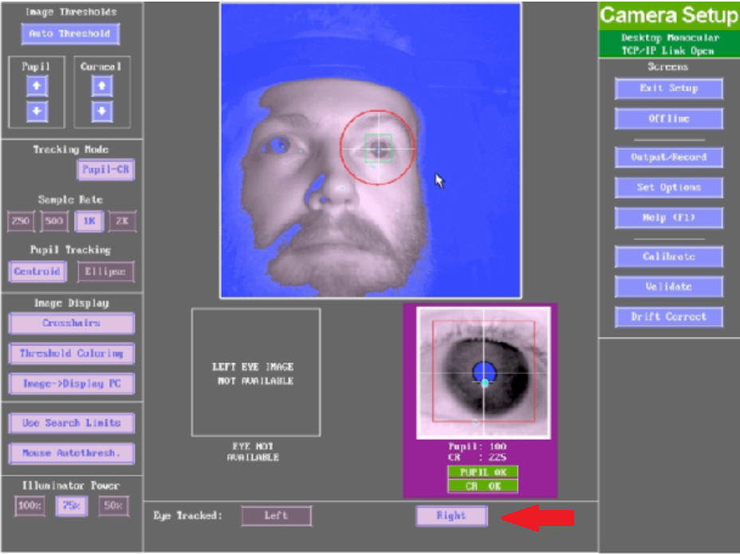
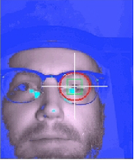
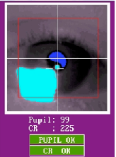
Adjust recording unit to the subject
Host computer desktop
if you want to track the right eye click “right eye” in the host computers user interface (the eye tracker can not automatically decide which eye it tracks on a subject, so it takes your input for granted)
The screen in the scanner room will turn black
if you now press > enter < on the host computer keyboard you will see the camera recording on the screen in the scanner room:
there are two modi one is the full camera mode ( you can use this to place the eye of interest in the center of the camera recording) The second mode is “zommed in” where you can fine adjust the camera
you can switch between modi by pressing the left or right arrow key on the host computers keyboard
Presentation monitor at scanner
Full camera mode
Zoomed-in mode

Slide 7
Adjust recording unit to the subject
camera
infrared
You need to position the recording unit (high speed camera and infrared light source) to each subject to have optimal results
For this reason you can move the presentation screen in the scanner room a little bit away again
The camera needs to be as centered on the mirror mounted on the head coil as possible, while the infrared unit can be in the periphery
there needs to be sufficient distance between the camera and the infrared source, and the infrared source should not touch the wall of the scanner tube
you can adjust the position of the camera by opening the three pod screw and move the whole upper mound, or move the camera horizontally on the mound by opening the one screw that it is fixed with
Tell subject to look at the center of the screen
Select the full camera mode (see above); turn the lens of the camera unit that you have a sharp picture of the subject eyes and place the eye of interest in the center of the camera recording ( you can tell the subject to blink the eye of interest to make sure you have the correct one, because everything is mirrowed ...)
Adjust the infrared unit that there is no shadow on the eye of interest; blue areas on the face are shadow, green areas are very bright; try to adjust the infrared unit as good as possible to have a nice picture of the eye
open the fresnel lense (lense on the infrared source) screws and pull it out that it shows the 80 mm mark (2 screws under the lense)
adjust the eccentricity of the whole infrared unit (screw on the main mount)
tild the infared unit up or down to be positioned correct

Slide 8
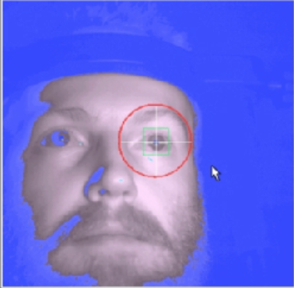
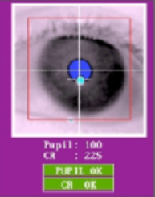
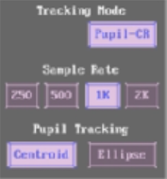
Adjust recording unit to the subject
Bad adjustment:
When the eye of interest is in the center of the camera recording & the infrared illumination is sufficient go to the host computer, double click the right eye, so the tracker adjusts a region of interest automatically and finds the pupil and the corneal reflection (CR) (these are the both things the eye tracker uses for its work)
Select “zoomed-in” camera mode, the camera zoomed on the eye
Go to the eye tracker again and turn the lens of the camera unit, till the corneal reflection has the smallest size
Now you are good to go and you can place the monitor in its correct position and leave the room
(if there are problems with tracking please read: “trouble shoot”)
If the eye lid overlaps half of the pupil ( often in Asian populations ) it is better and more accurate to track the pupil as Ellipse (the camera recognizes the pupil and an algorithm abstracts from its ellipsoid geometry the real center of the pupil)
Good adjustment:

Slide 9
Perform eye tracker calibration
You are now outside of the scanner, everything is prepared for the actual experiment
Press „a“ on the host computer keyboard to auto-adjust pupil reflection and CR threshold
the values for the pupil threshold should be between 75-110
the values for the corneal threshold should be < 230
→ if they are not in these ranges, manually adjust them to be in these ranges (+/- buttons under the camera field on the host computer)
Initialize the calibration of the eye tracker by pressing „c“ on the host computers keyboard
Start calibration by pressing the > spacebar <
(a calibration is accepted if there is a sufficiently long fixation on the calibration point on the screen (=auto accept), if the calibration does not automatically moves on, the auto accept might be disabled; you can also accept the fixations separately by pressing the spacebar if the subject fixated on a fixation point)
The mean error in the calibration should not exceed 0.35 and its maximum should be lower than 0.75
if these ranges are reached, press > enter < to accept the calibration
If the calibration was very bad except it and start it again by pressing “c“ again
Good calibration
bad calibration

Slide 10
Perform eye tracker validation
validation by pressing the > spacebar <
(if problems same solutions apply like stated for the calibration)
Accept validation by pressing > enter <
Now the calibration is done
Press „o“ on the host computer keyboard to proceed with you Matlab script (=start experiment)
Suggestions to improve the calibration performance:
Watch for the pupil or CR warning signals on the tracker screen due to pupil occlusion or improper thresholding
Corneal reflection should not be lost or misidentified when the subject looks at any area of the display
Calibration luminance should be similar to that of experiment
Ask participant to look at center of bull’s eye
Tell the subject to not anticipate the upcoming fixation, but only move their eye once the next fixation actually already appeared (this does happen often as the subjects want to be done fast)
unexperienced participants might need some practice

Slide 11
Run experiment
The more often you do a calibration, the more precise your recordings will be
If you want to analyze microsaccades,… you might want to do a new calibration after each run
Eye tracker also provides drift correction, please read EyeLink manual for this

Slide 12
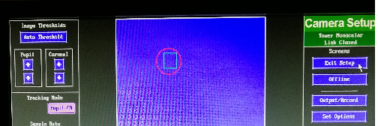
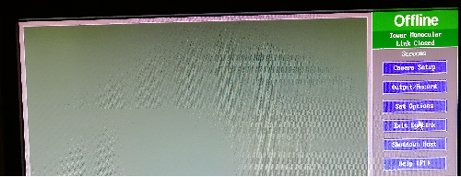
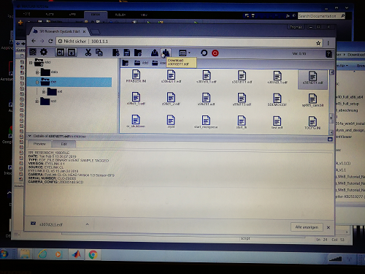
Access Data
After the experiment press „Exit Eyelink“ on the users interface of the host computer
Now you can enter the File-Manager on the host computer
In the moment you do this you can now also see the file manager in an open explorer window on your presentation computer if you type in the IP address from the host computer ( 100.1.1.1 )
You now click on the data structure that is shown on the left side in your browser window on “exe” (this was basically a linkage mistake by eyelink as the data should obviously be in the folder “data”, but it will be in “exe”
In “exe” you will find the name of the file that you saved (the name of the *.edf file that you created and named in your Matlab script)
You can now download it to your computer using the downloading button
On host computer
On stimulation pc, explorer window

Slide 13
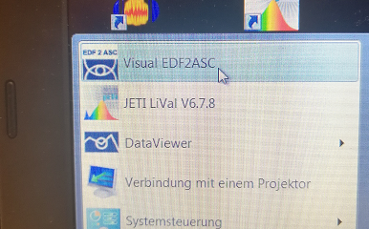
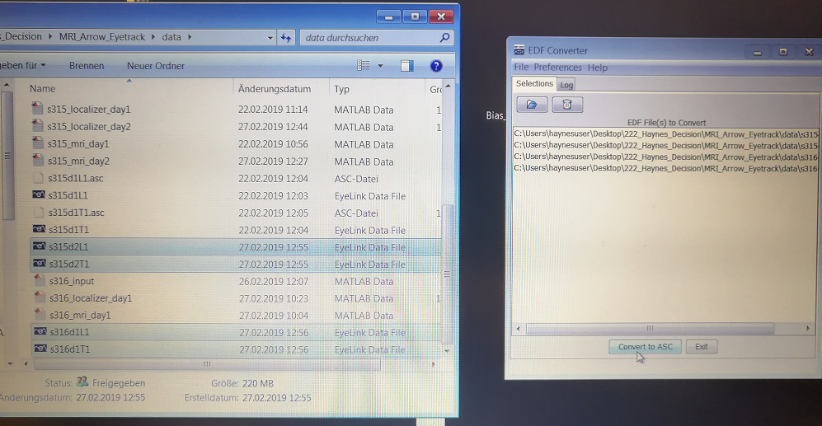
Access Data
If you installed all the software that was contained on the EyeLink USB drive (see 2nd slide of this presentation) you have a software that is called edf2asc.exe on your machine
Open the software and drag and drop the *.edf file of interest in that window, click extract and your *.edf file is extracted to an *.asc file
Once you obtained the *.asc file you can access the data with MatLab -> please read Powerpoint presentation “Analyse_EyeLink_Data”

